Slide 1

Section 1.5 Complex Numbers
Lecture 1
Complex Number System

Slide 2

Section 1.5 Homework Submission to Canvas
Preview of section
Skim the section in text and write a short paragraph summary.
Give a bulleted list of all important definitions, theorems, and formulas without details.
Notes on video lectures
Take notes on everything written on slides including all details, worked examples, on-own activities, as well as your own thoughts and questions.
Try on-own activities first, then write down provided solution next to it for comparison.
Worked examples from the text
Write down the problem and attempt without looking at the solution.
Use the solution to write the best explanation you can.
Solutions to textbook exercises
Model approaches and explanations given in the video lectures and textbook examples.
Final reflection of section
List the key takeaways to remember as a bulleted list.

Slide 3
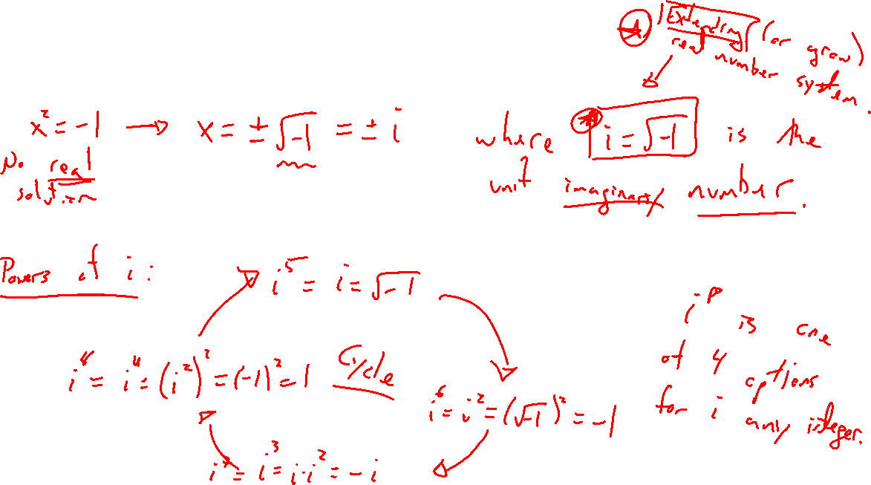
Imaginary Solutions to Quadratics
Notes:
x^2 = -1 not solvable with real numbers. Extending our real number systems allows for a solution.
Imaginary number: i = \sqrt{-1}, powers of i, I^2, I^7,...

Slide 4
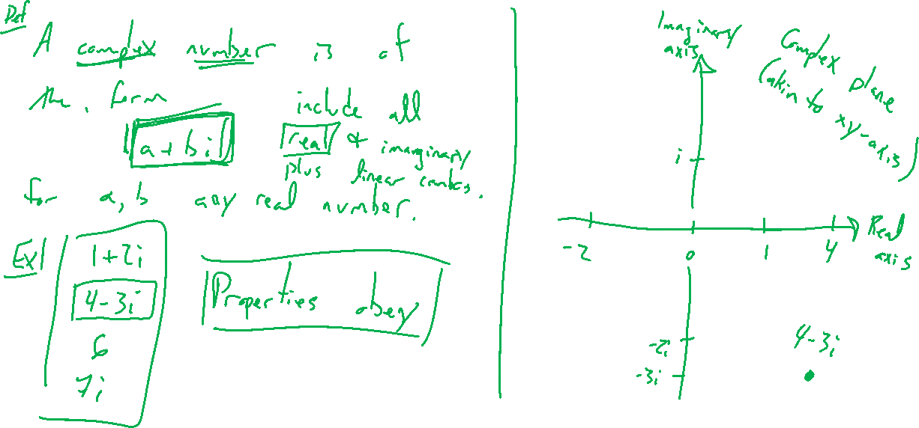
Complex Numbers and the Complex Plane
Notes:
Real numbers, imaginary numbers, add to get complex numbers in complex plane. Real and imaginary part
Think of an extension of real numbers to allow more room.
Complex conjugate

Slide 5
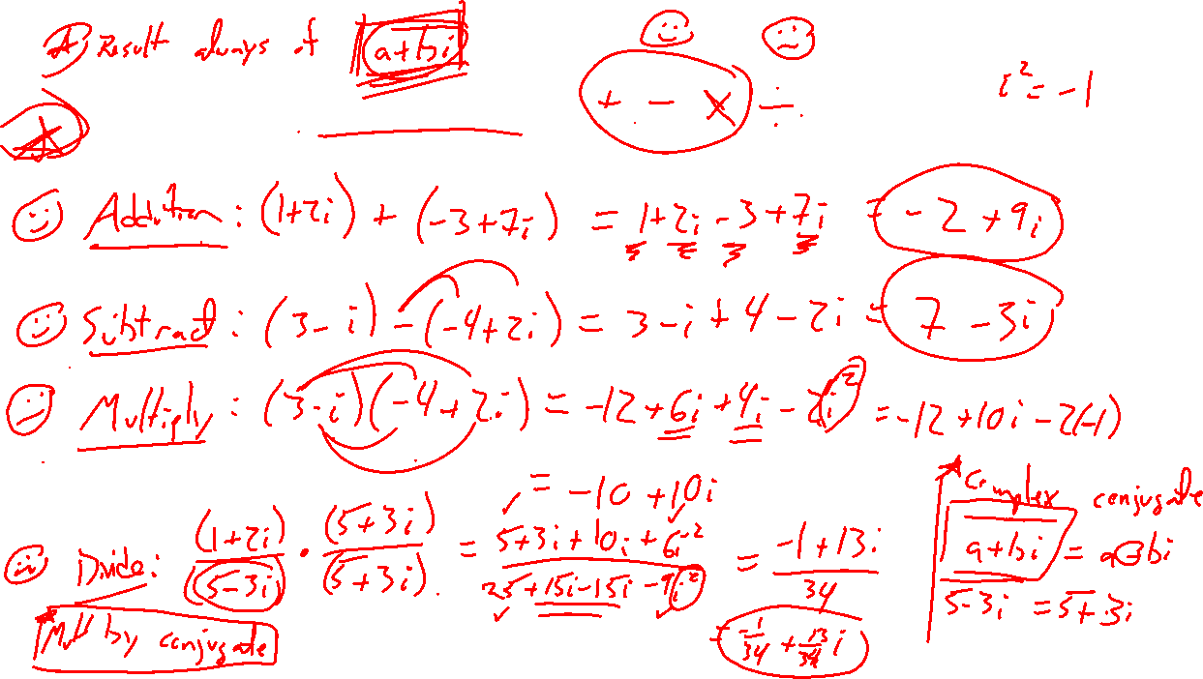
Complex Arithmetic
Notes:
Add / subtract
Multiply
Divide

Slide 6
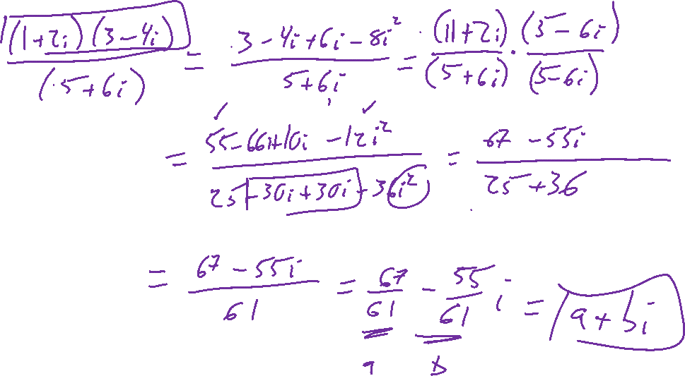
Example: Try on Own
Notes:
(1+2i)(3-4i)/(5+6i)

Slide 7
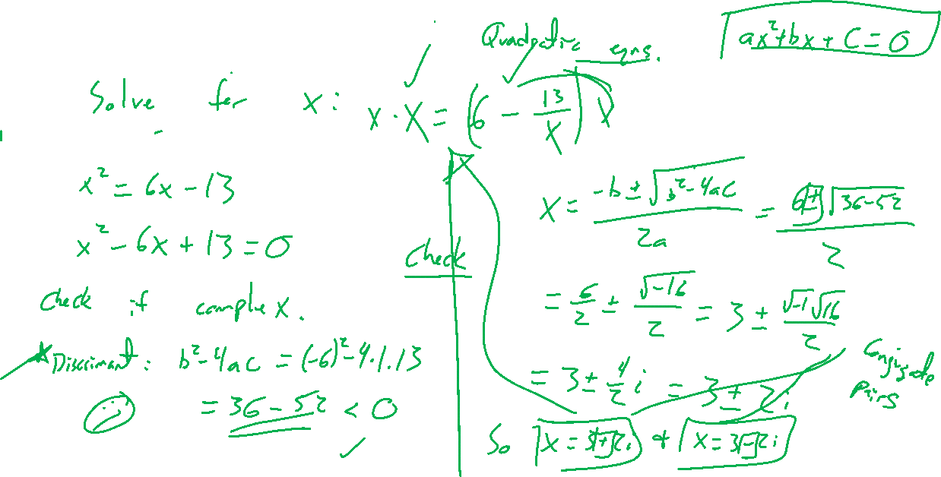
Example: Try on Own
Notes:
Solve for x: x=6-13/x
Note a quadratic, check the discrimant for them to know expect complex.
Verify one of the solutions, can see where conjugate comes from

Slide 8

Section 1.5: Textbook Examples and Exercises
Rework examples 1, 2, 3, 4, 5, 6 in the text. Steps:
Write down a problem.
Close the book and attempt on own.
Check / correct your solution against the text solution.
If needed, rewrite the problem to be of the quality of the text solution.
Complete exercises 15, 23, 31, 33, 41, 57, 71
Write solutions of the same quality as in lecture and text solutions.
Check your solution against the answer in the back of the book.

Slide 9

Section 1.5 Homework Submission to Canvas
Preview of section
Skim the section in text and write a short paragraph summary.
Give a bulleted list of all important definitions, theorems, and formulas without details.
Notes on video lectures
Take notes on everything written on slides including all details, worked examples, on-own activities, as well as your own thoughts and questions.
Try on-own activities first, then write down provided solution next to it for comparison.
Worked examples from the text
Write down the problem and attempt without looking at the solution.
Use the solution to write the best explanation you can.
Solutions to textbook exercises
Model approaches and explanations given in the video lectures and textbook examples.
Final reflection of section
List the key takeaways to remember as a bulleted list.

